Slide 1

A Case Study in Talent Management
By Ben Goodwin

Slide 2
Project Deliverables
What are the primary drivers of attrition?
Identification of job role specific trends
Model for predicting attrition
Model for salary prediction

Slide 3
QOI: What factors lead to attrition?
Data contains 38 variables concerning employee retention
Heavily skewed towards non-attrition (140 vs 730)
Attrition has many root causes, identifying three variables from data that “most contribute” may not paint the whole picture
Proposed Solution: Principal Component Analysis
Idea: Use linear algebra to project all 38 variables onto a higher dimensional plane, rotate them with the goal of dimension reduction
More plainly: Take the dataset, perform some calculations to rearrange the variables as linear combinations of one another called principal components
Attrition dataset is left with 15 PC’s that account for 81% of total variation in data
We are left with fewer, yet more robust variables which give insight into attrition.
The three PC’s which account for the most variation in the data will be analyzed as attrition factors

Slide 4
Attrition Factors
Approach to selecting attrition factors
Use PCA to reduce dimensions of attrition data
27 of the original variables selected
Salary information reduced (monthly income kept)
Non-varying variables eliminated (work week hours and over18)
PCA reduced data to 15 components capturing 81% of variation
Three PC’s selected based on their relationship to attrition
Each PC is a linear combination of original 27 variables now contained in PC

Slide 5
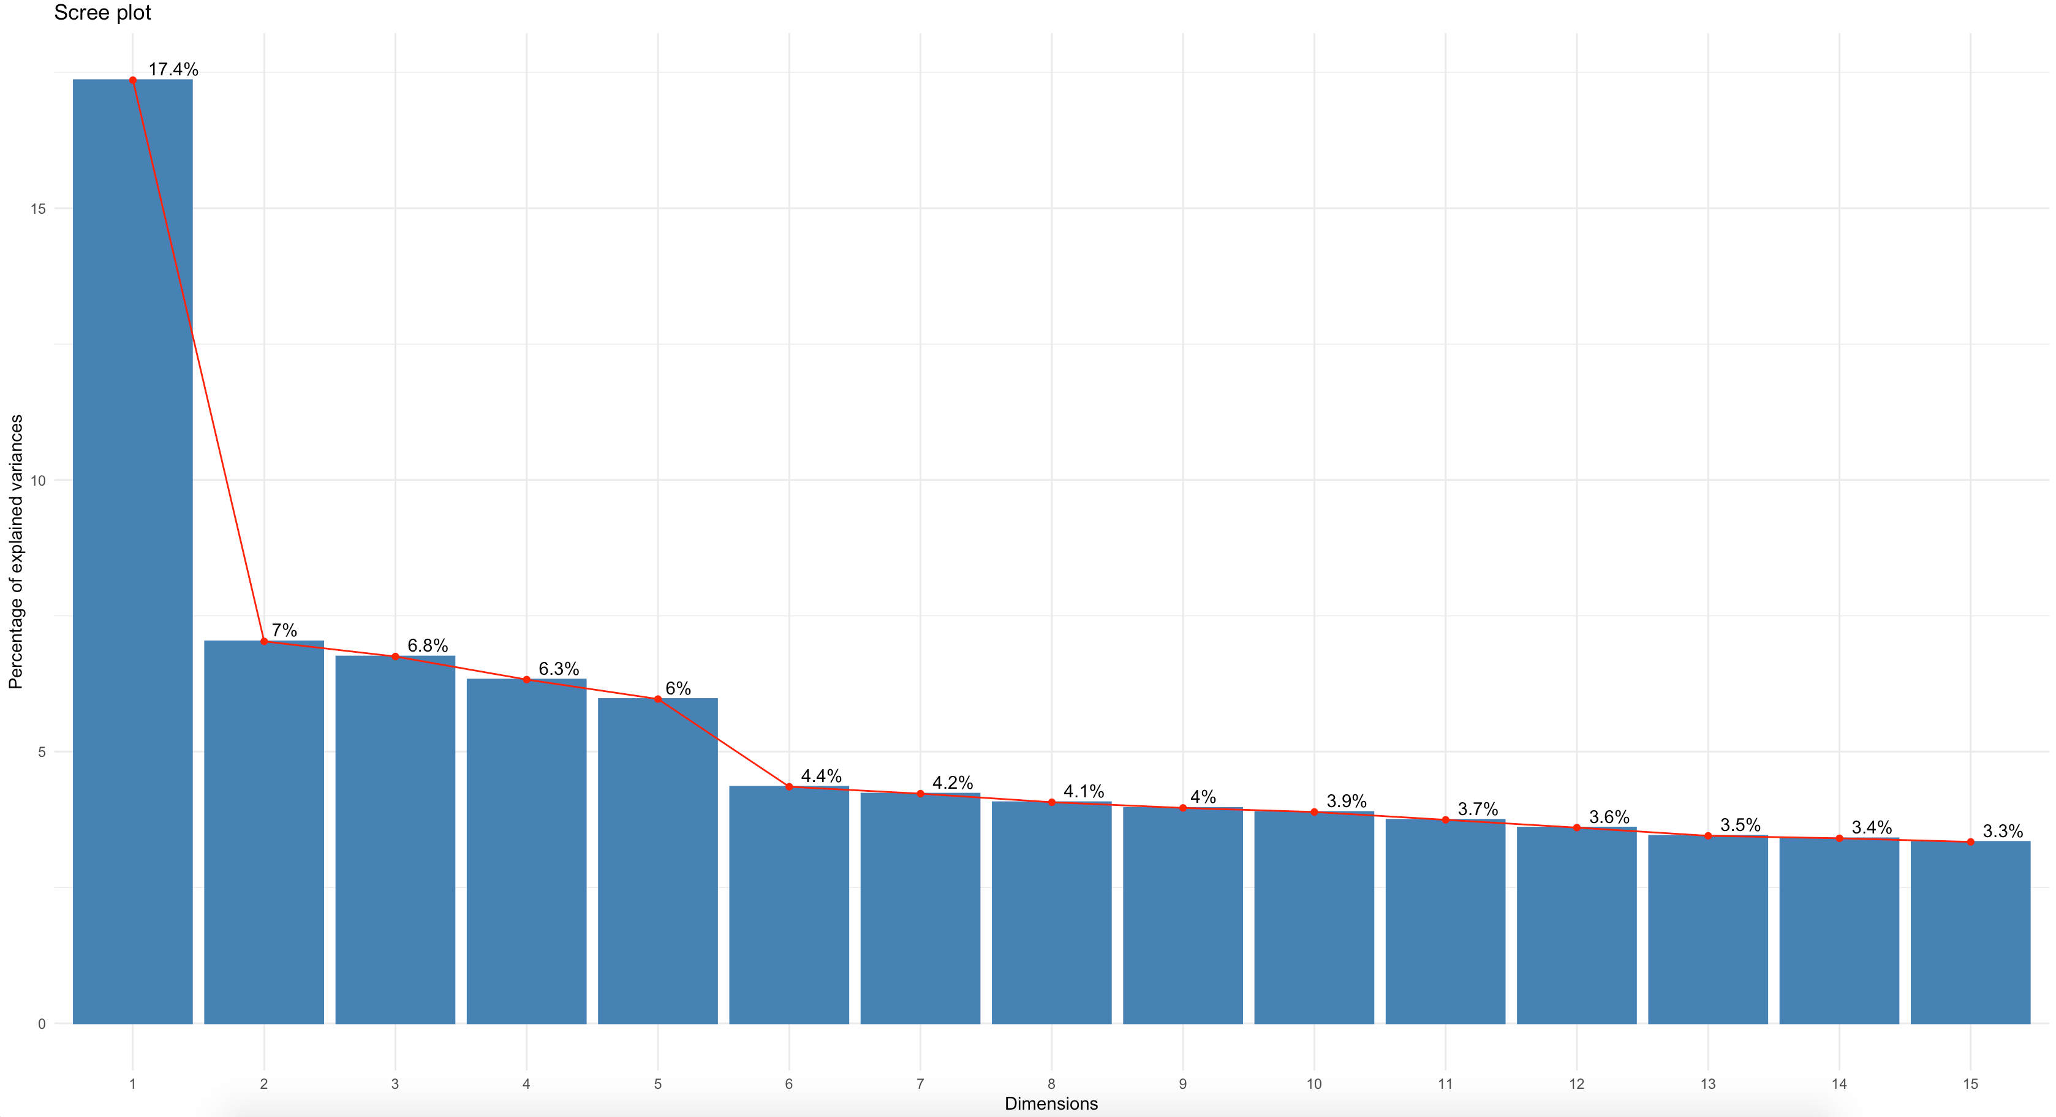
Attrition Factors Component Selection
Key Takeaways
PC1 has most influence
15 PC’s account for 81% of data variance
Certain PC’s tend toward attrition

Slide 6
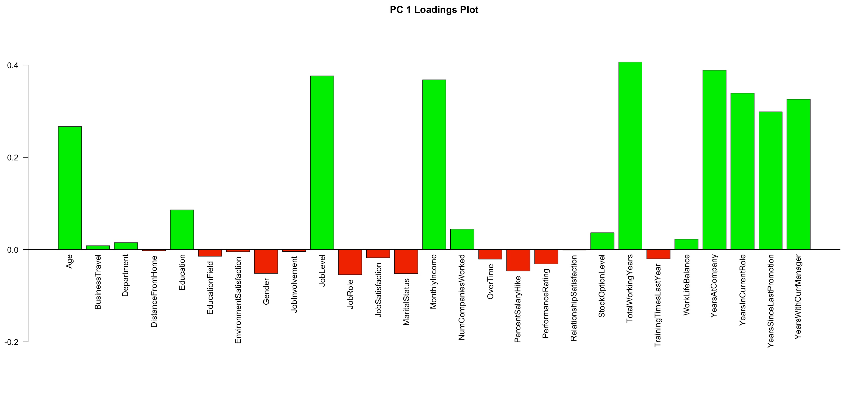
Component 1 Loadings
Key Loadings for PC1
Total working years (+)
Years at company (+)
Job level (+)
Monthly income (+)
The first component is positively correlated with total working years, years at company, job level, monthly income. This suggests the give variables vary together and when one goes down, the others decrease as well. The component could be considered a primary measure of career length and longevity and well as a measure of success.

Slide 7
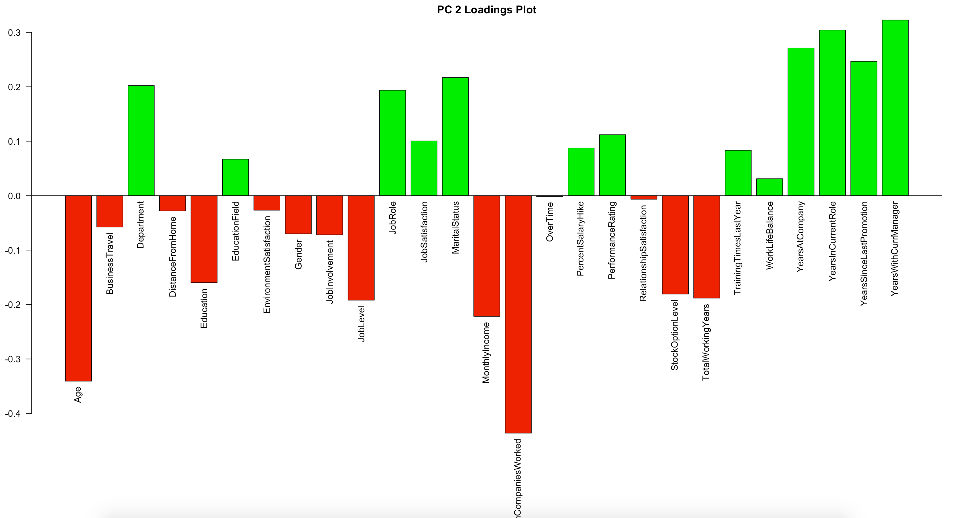
Component 2 Loadings
Key Loadings for PC2
Number of companies worked (-)
Age (-)
Years with current manager (+)
Years in current role (+)
The second component is mostly correlated with number of companies worked, and age, but in a negative direction. Years with current manager and years in current role are correlated with the second component in the positive direction, which indicates that as number of companies and age decrease, years with current manager and years in current role increase.

Slide 8
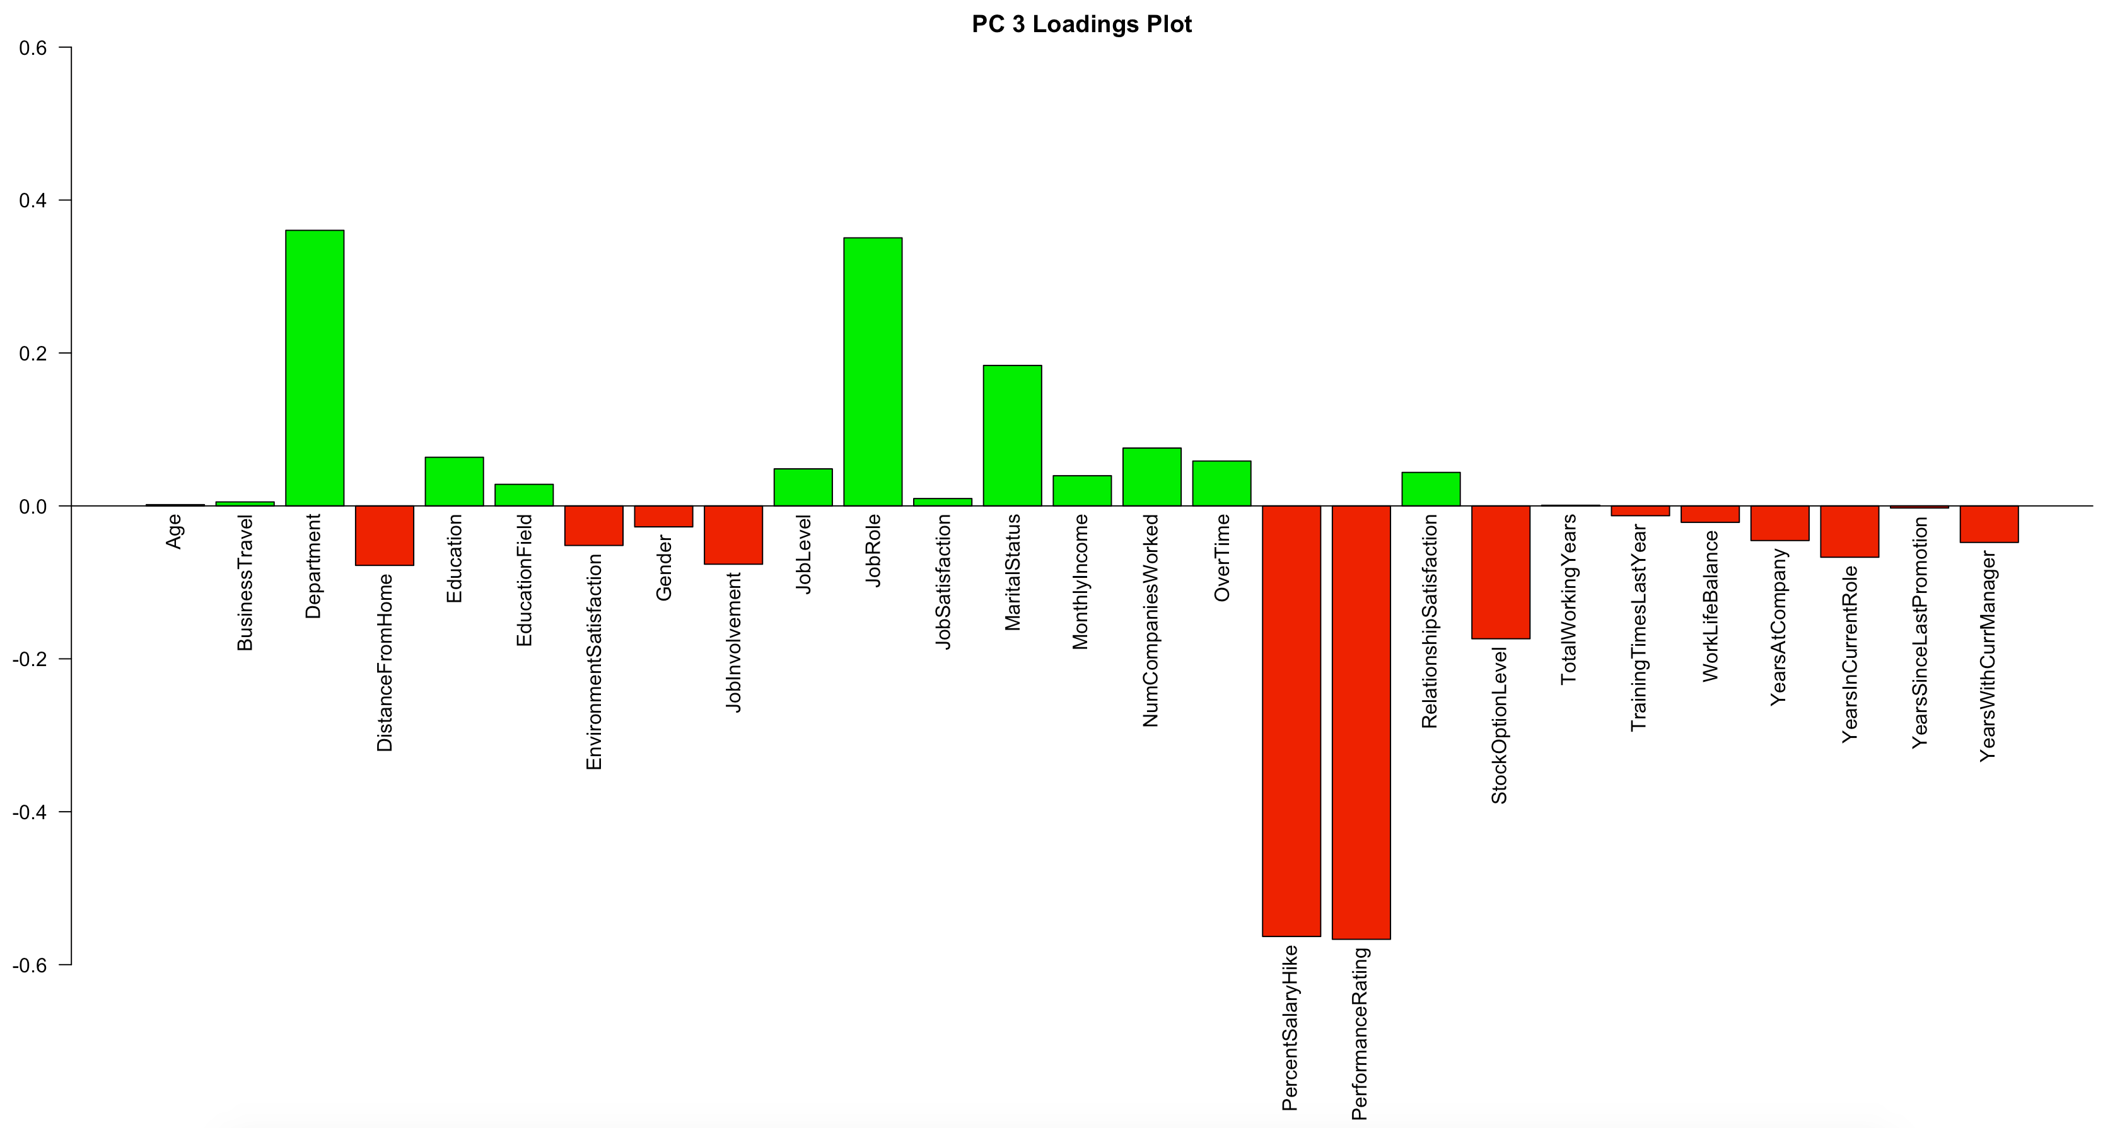
Component 3 Loadings
Key Loadings for PC3
Performance Rating (-)
Percent Salary Hike (-)
Department(+)
Job role (+)
The third component is most correlated with performance rating and percent salary hike, both in a negative direction. Department and job role are correlated with the third component in a positive direction, suggesting that as performance rating and percent salary hike decrease, department and job role increase.

Slide 9
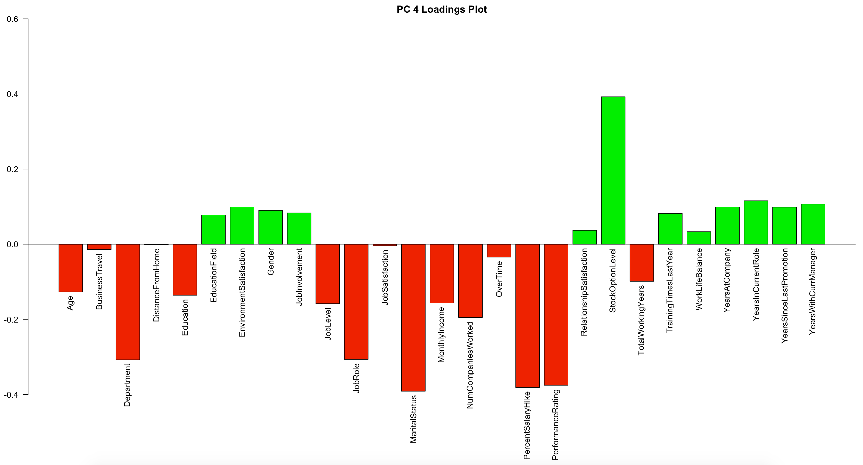
Component 4 Loadings
Key Loadings for PC4
Stock option level (+)
Marital Status (-)
Percent Salary Hike (-)
Performance Rating (-)
The fourth component is most correlated with stock option level. Martial Status, percent salary hike, and performance rating are correlated with the fourth component, but in a negative direction. This suggest that as stock option level increases, martial status, percent salary hike, and performance rating decrease.

Slide 10
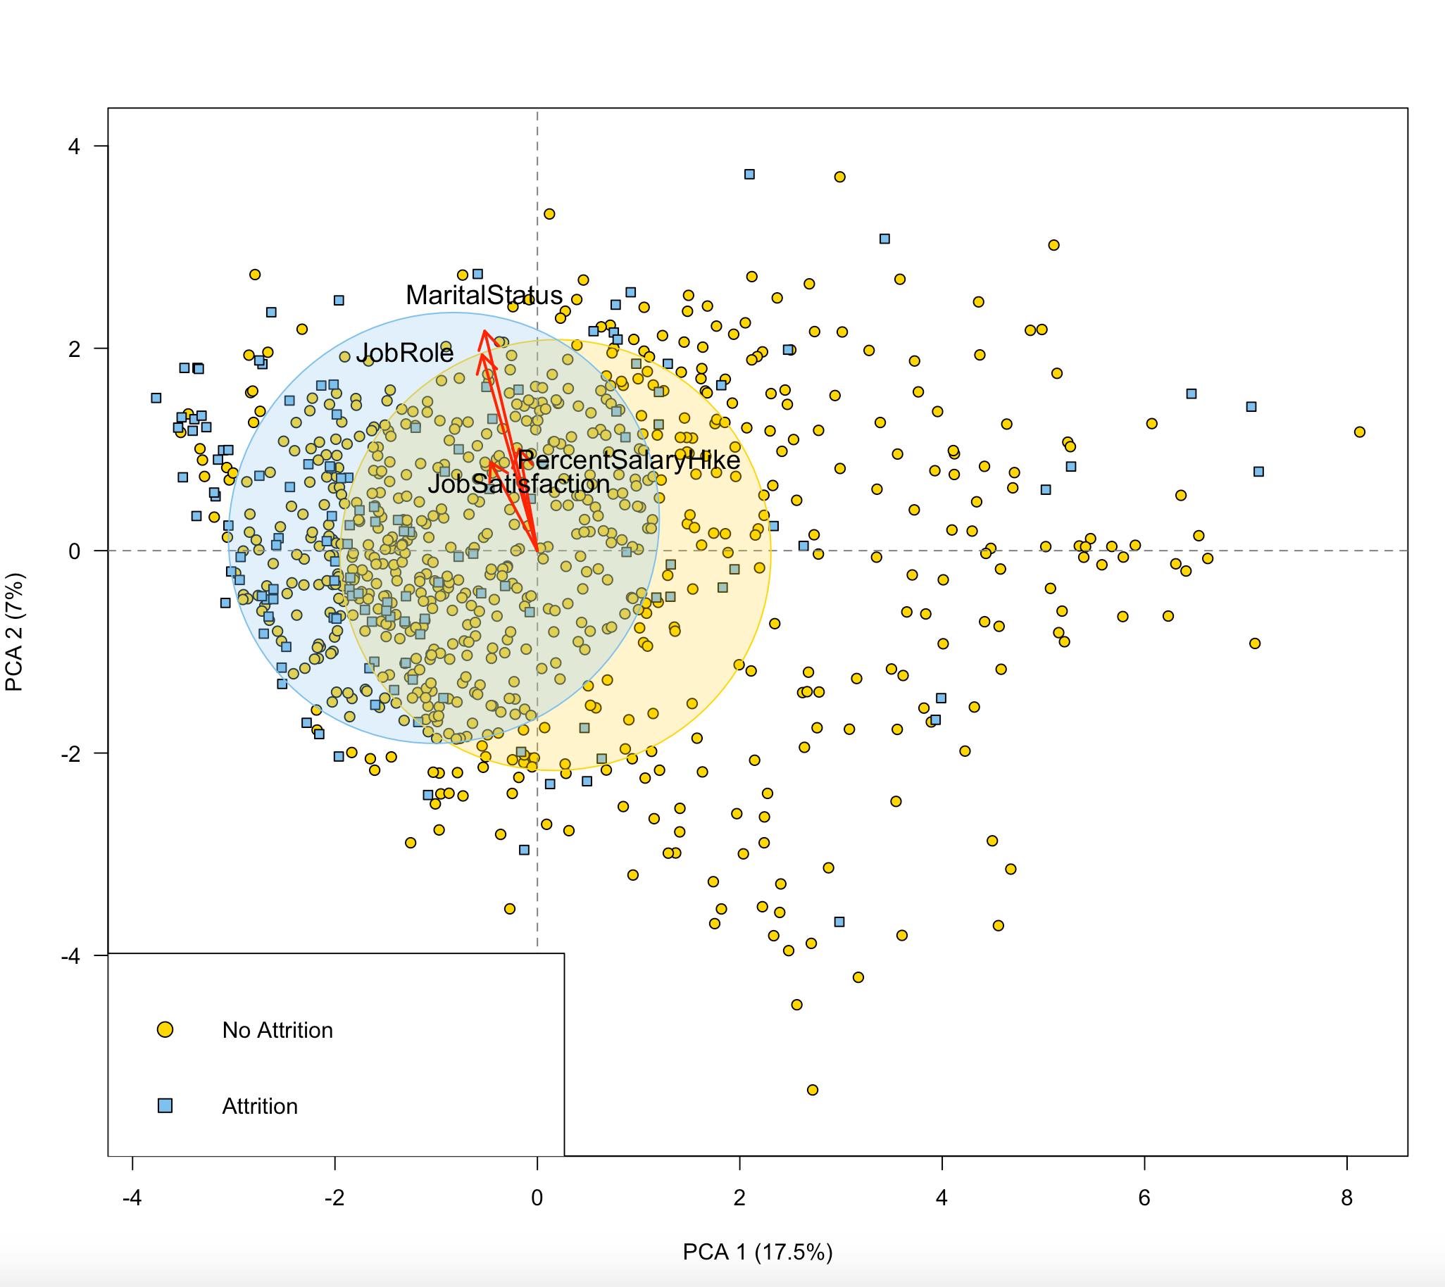
Attrition Bi-Plots for PC1 and PC2

Slide 11
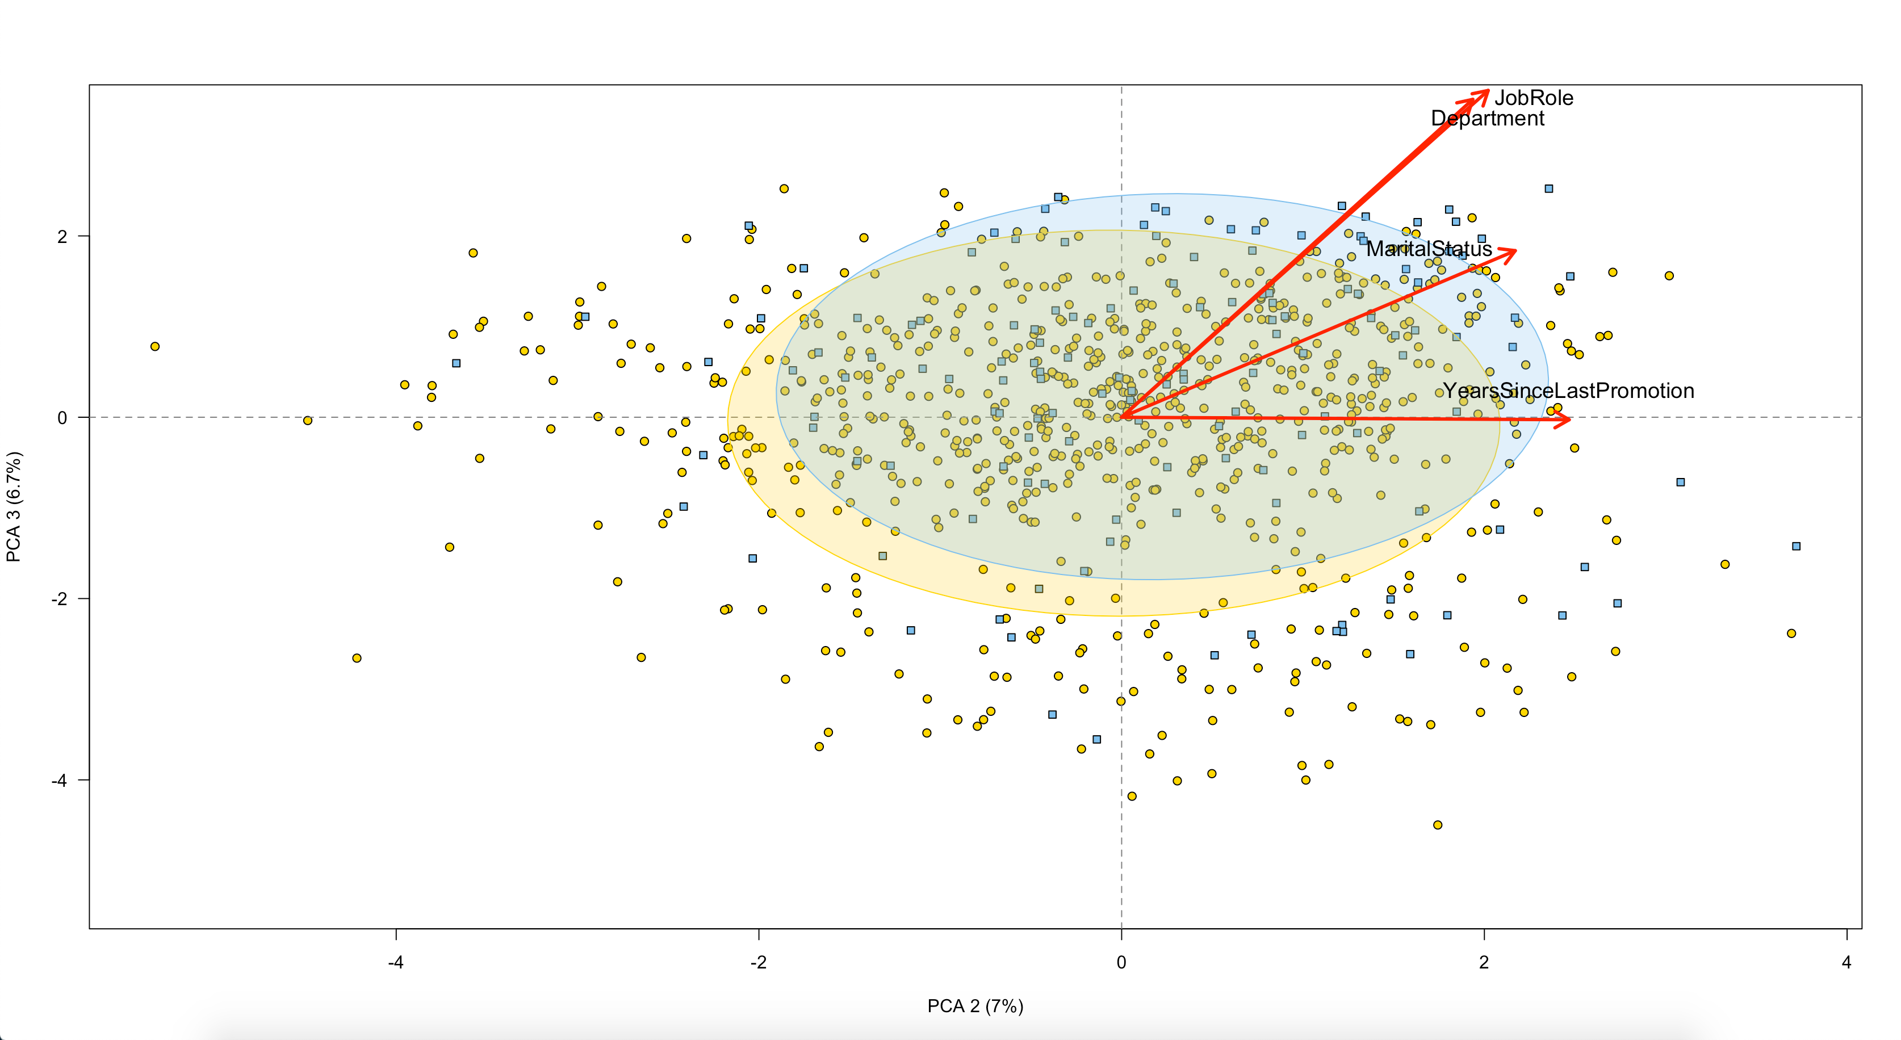
Attrition Bi-Plots for PC2 and PC3

Slide 12
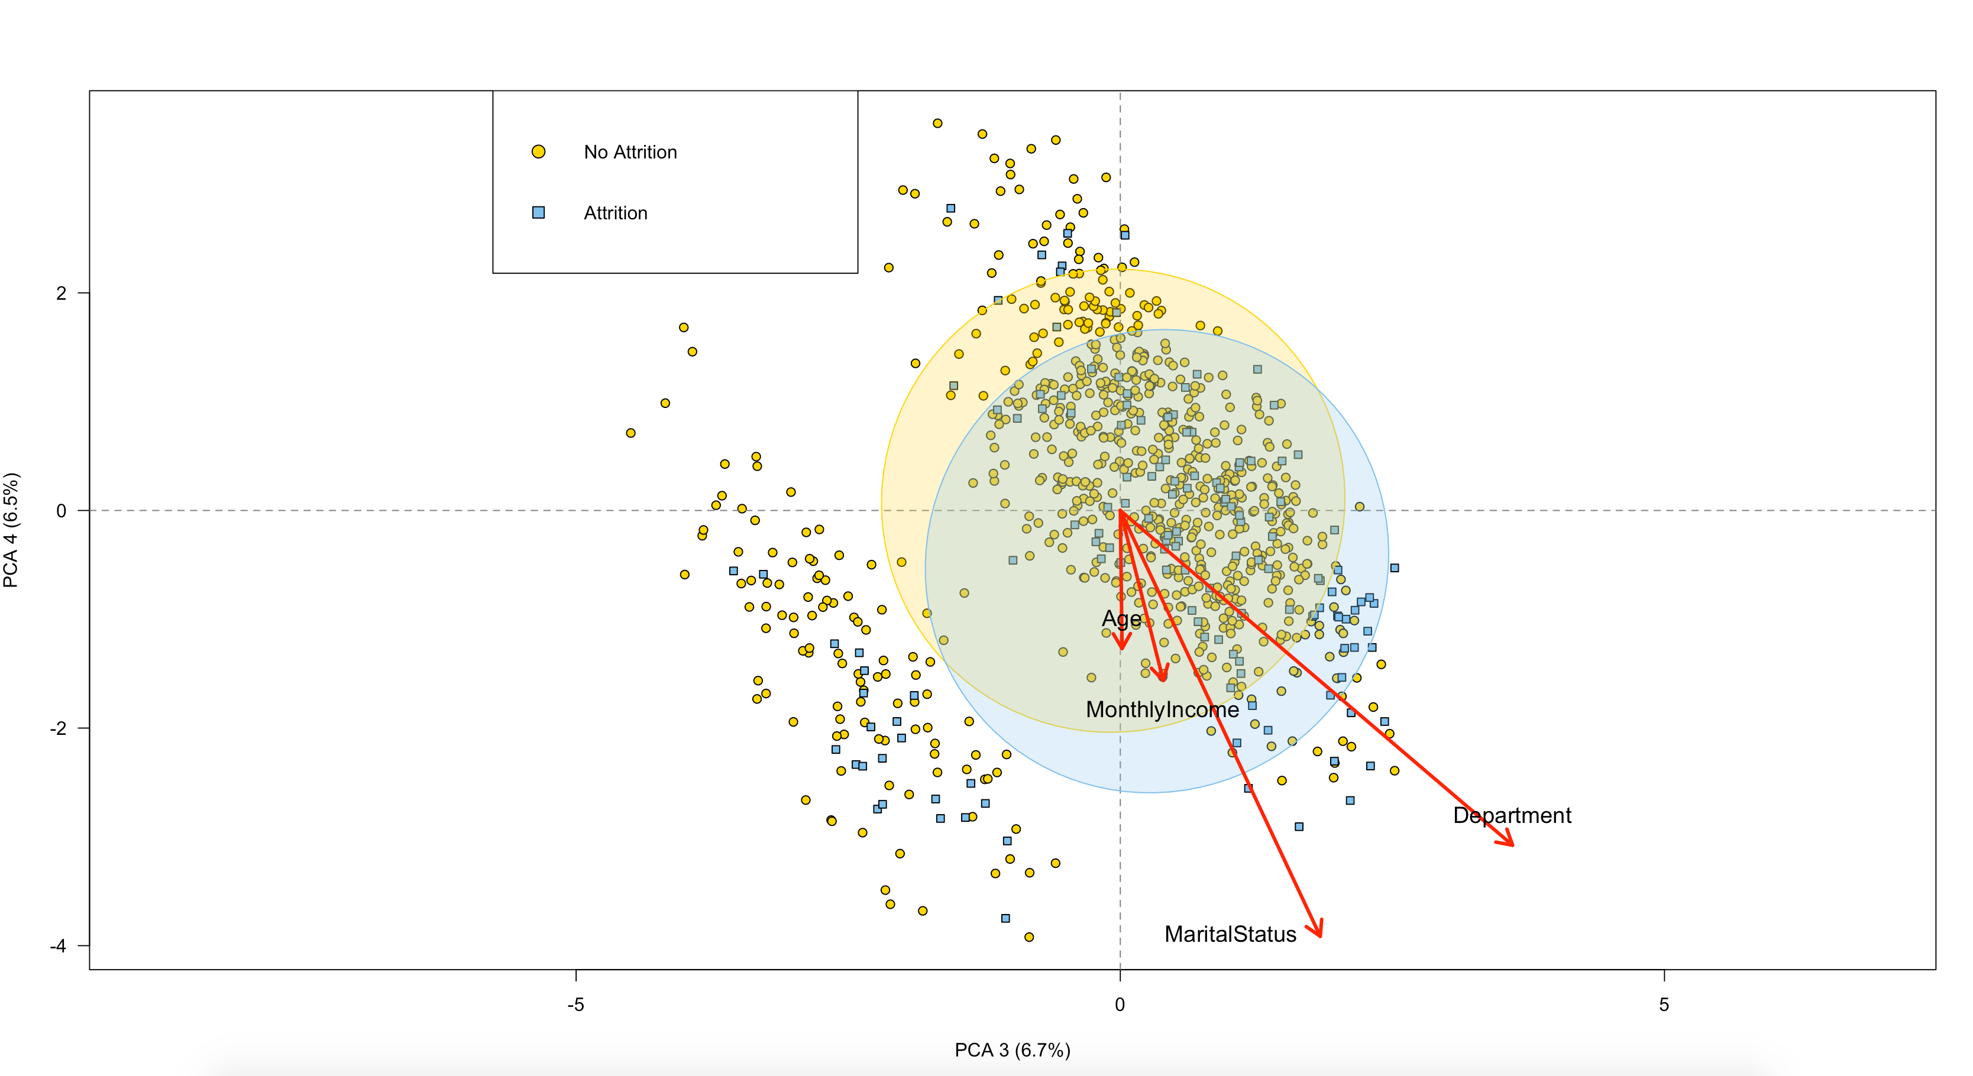
Attrition Bi-Plots for PC3 and PC4

Slide 13
Attrition Takeaways
There is a fine line between those who leave their jobs and those who do not
When plotted alongside PC’s, there is lots of overlap between the groups
Certain elements of the components have loadings with high magnitude that point in the direction of the attrition group
Certain loadings seem to significantly contribute to those in the attrition group.
Martial status appeared in all three bi-plots
Department appeared in two bi-plots
Job role appeared in two bi-plots
We can use the PC’s to combine all the variables and use the PC to generalize about job characteristic's.
For example, we can say that PC3 is a good indicator of which variables to look at when determining an employee's potential for attrition.

Slide 14
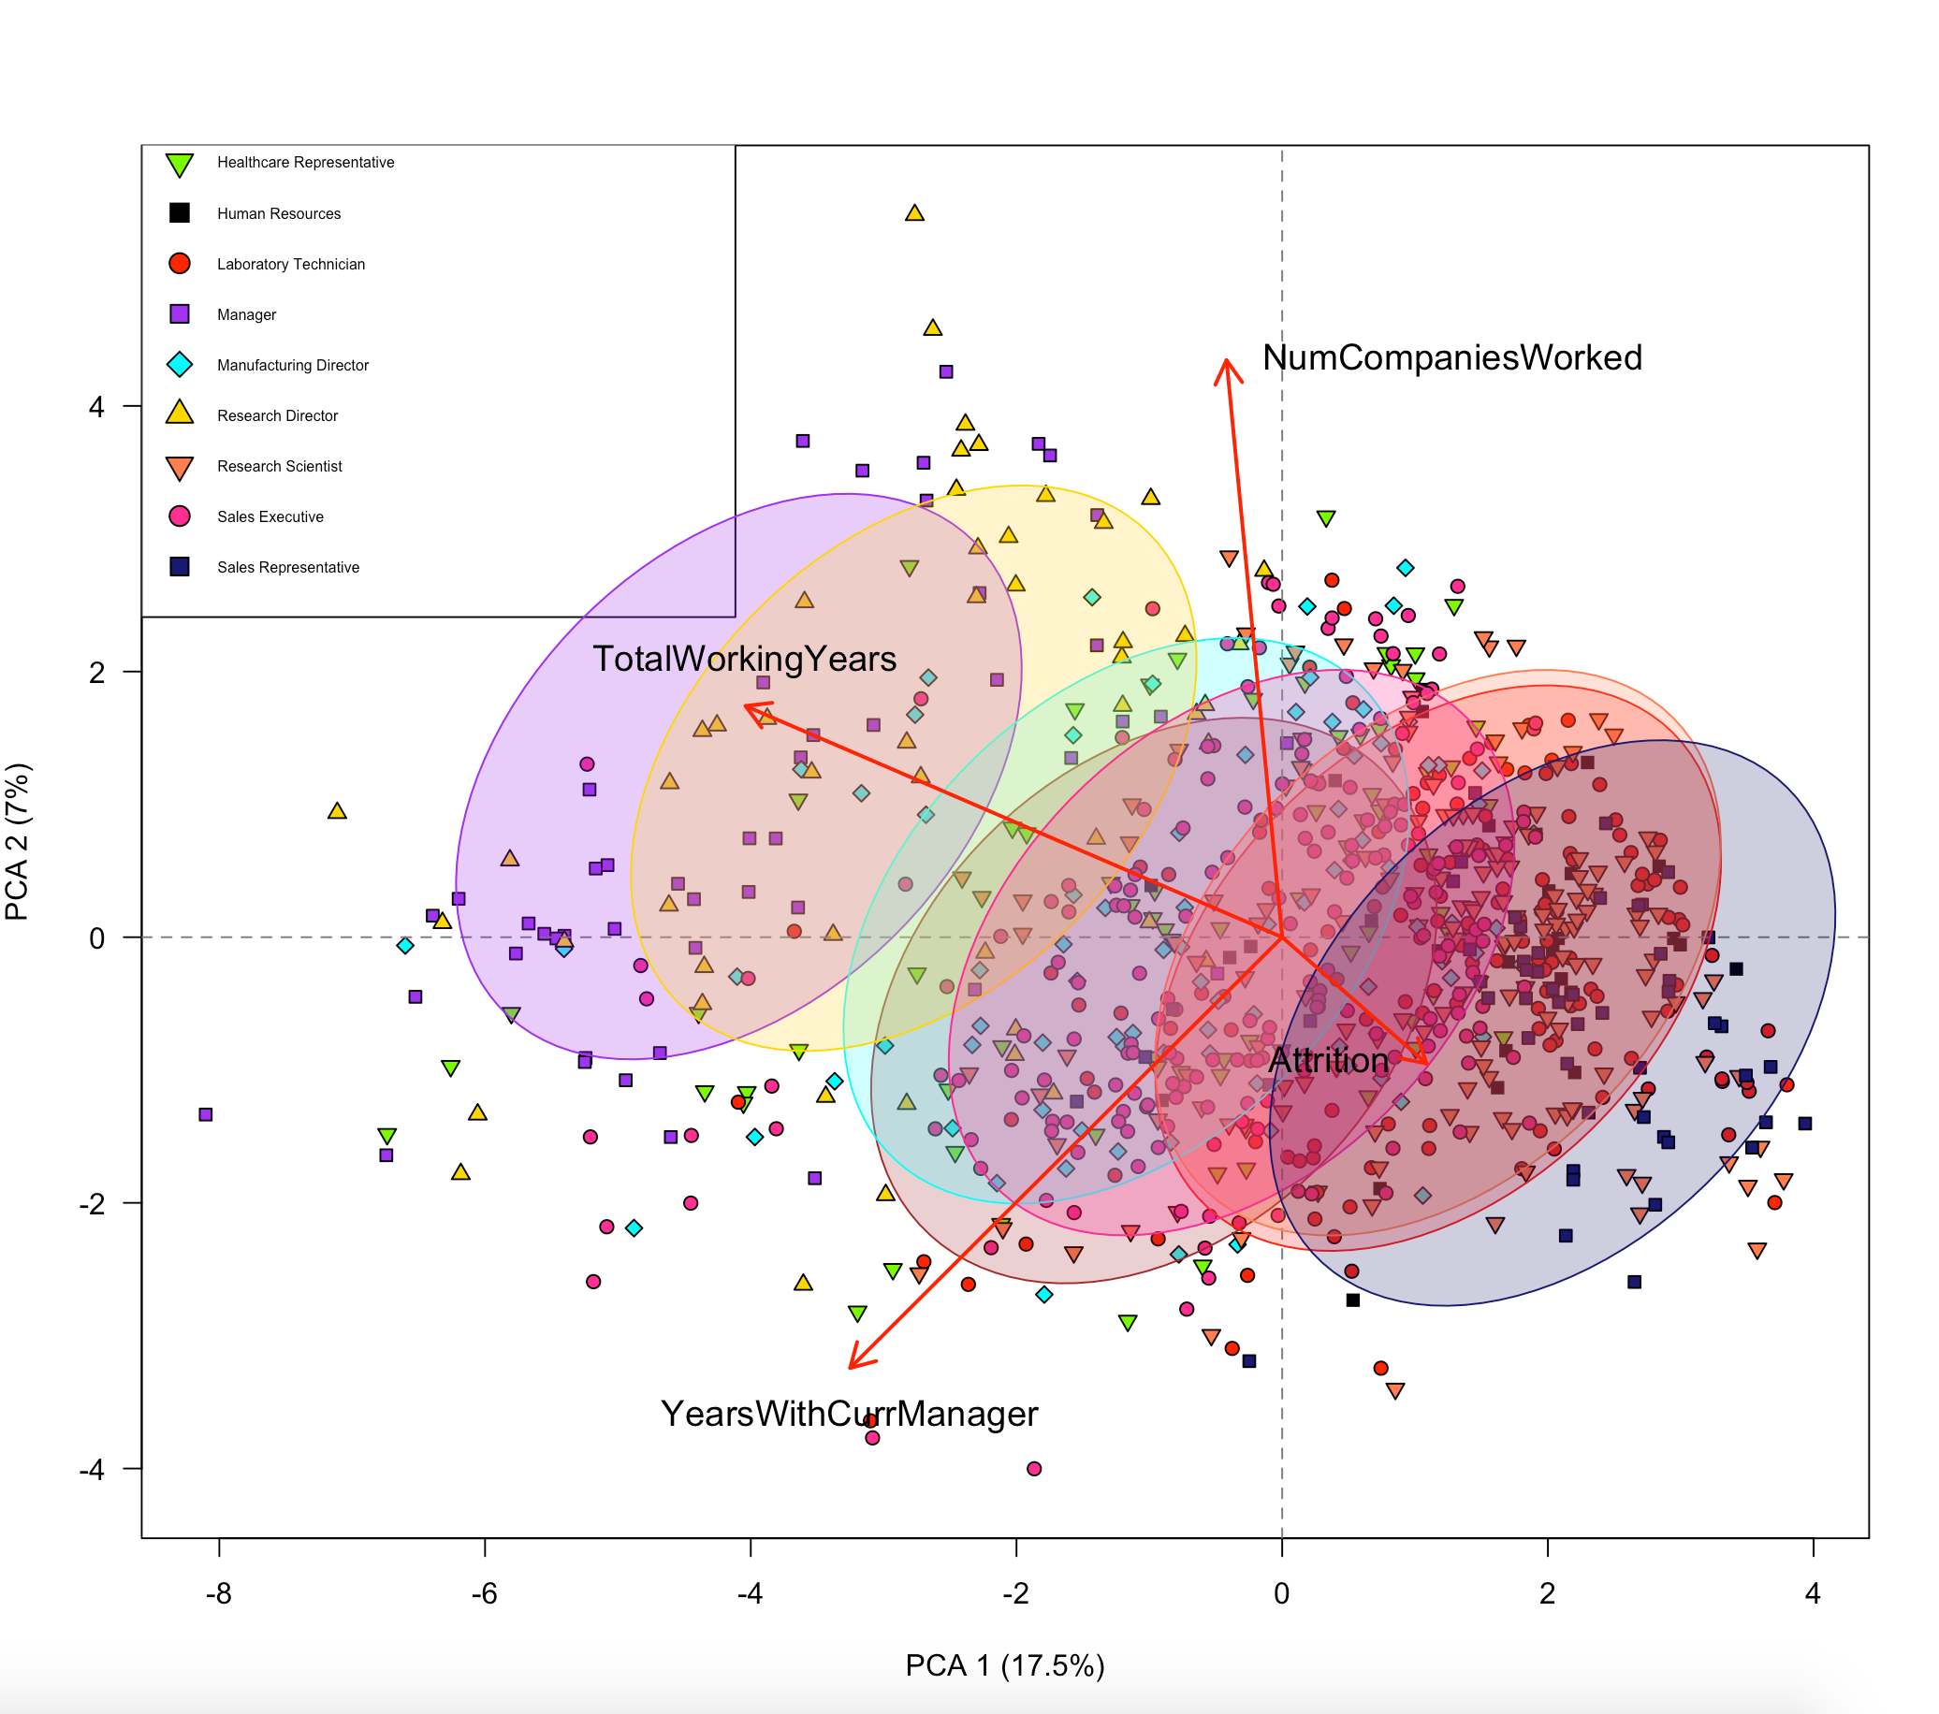
Job Role Specific Trends (PC1, PC2)

Slide 15
Job Role Specific Trends Takeaways
Job roles tend to cluster around each other
Certain roles tend to be more positively associated with loadings from PC1 and PC2
Managers and Research Directors tend to be more heavily associated with years of experience
Sales representatives and sales directors are associated with attrition in the negative direction
Number of companies worked lands squarely in the middle of the pack and doesn’t seem to have much bearing on job role.
Years with current manager doesn’t seem to point to job roles in a specific direction, indicating should one wish to pivot, they should develop attributes more in line with intended role

Slide 16
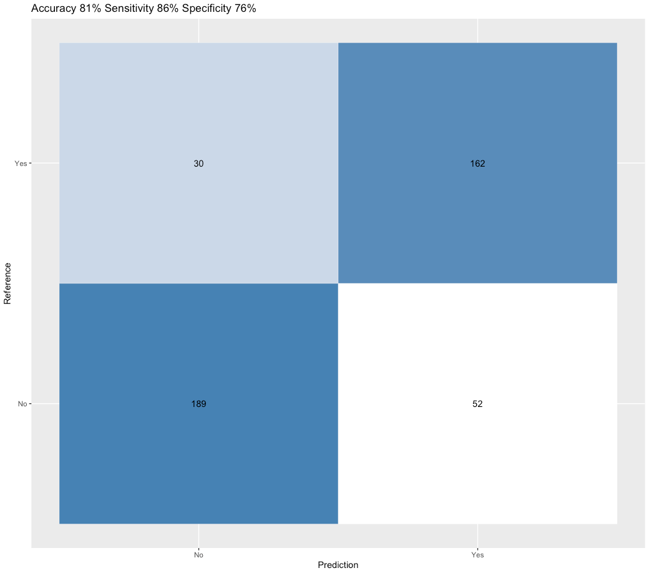
Attrition Classification
Naïve Bayes Classifier
Excellent for binary classification
Data heavily unbalanced
Oversampling was used to increase training accuracy
81% accuracy
86% Sensitivity
76% Specificity
No Yes
189 52
No
Yes
30 162

Slide 17
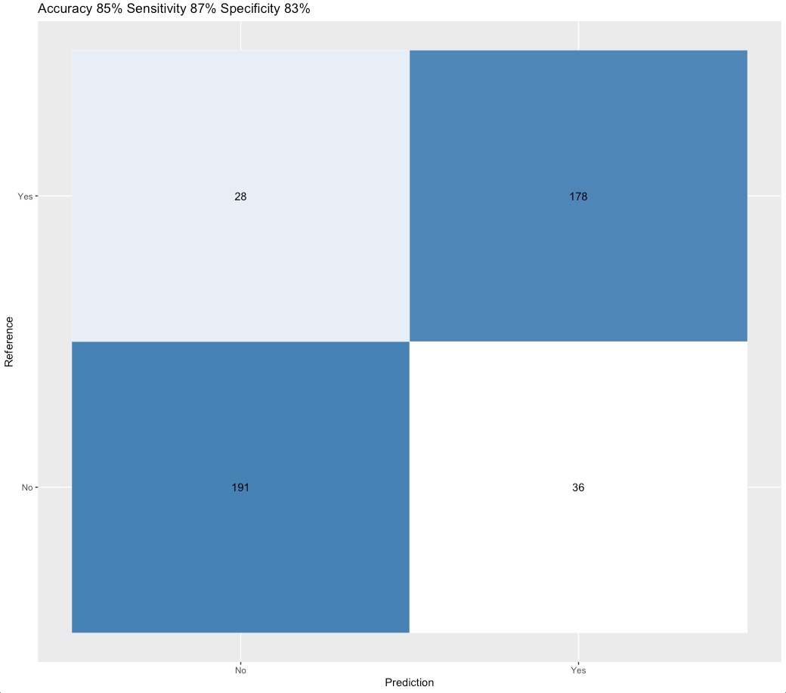
Attrition Classification
Regularized Discriminant Analysis
Excellent for binary classification
Data heavily unbalanced
Oversampling was used to increase training accuracy
85% accuracy
87% Sensitivity
83% Specificity
No Yes
156 29
No
Yes
26 149

Slide 18
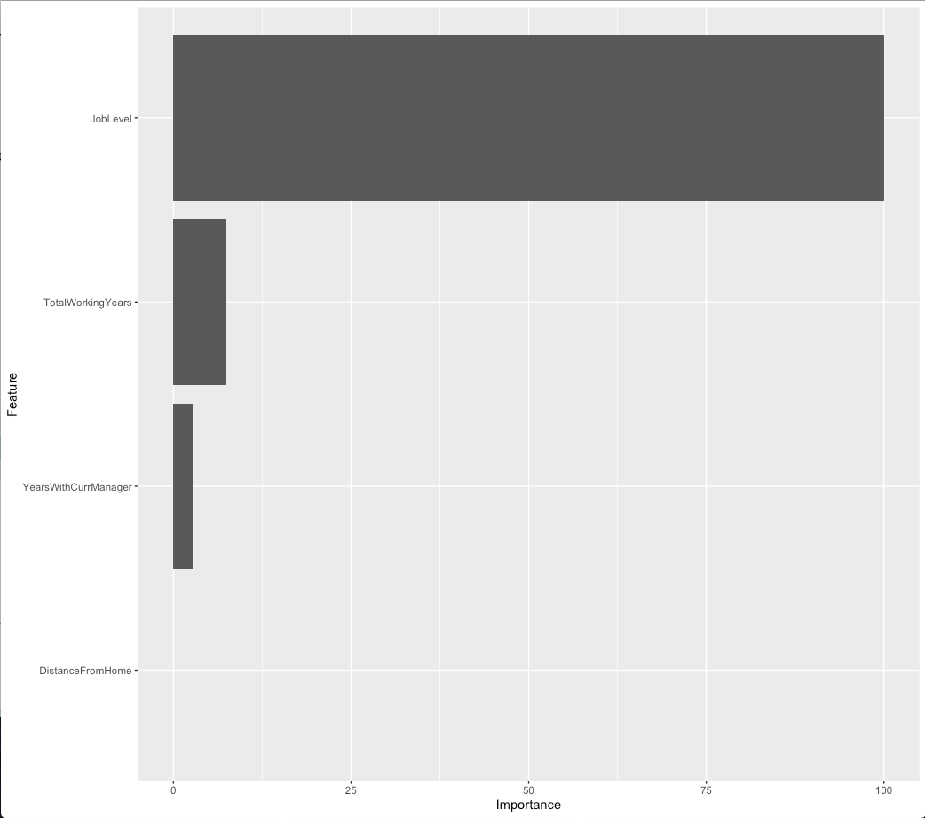
Salary Classification
Linear Regression
Salary information is more nuanced compared to attrition
Monthly Income is a continuous Variable
Original 27 predictors cause too much noise
Reduced to four variables
RMSE: $1368.84
Entire model significant
All four predictors are far below 0.05
General model is far below 0.05
91% of variance is accounted for

Slide 19
Key Takeaways
Attrition is a challenging variable to predict
Identify characteristics of job roles to take them on
Attrition can be classified with high precision
Salary info can be estimated with four predictors

Slide 20
YouTube and Github Links
Bgoodwinsmu.github.io
https://youtu.be/UtNPEyfNsoY

